Slide 1
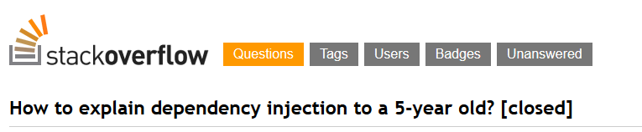
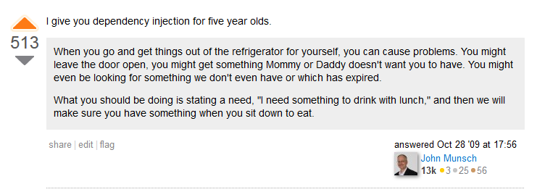
http://stackoverflow.com/questions/1638919/how-to-explain-dependency-injection-to-a-5-year-old/1638961#1638961
Notes:
TODO : add screenshot from StackOverflow

Slide 2

Dependency Injection, the right way
Thibaud DESODT
@tsimbalar
Notes:
TODO :add SoftShake Logo
Present you self

Slide 3
About
Who am I
What I’ll talk about
What I won’t talk about
Expectations
Not about specific containers .. Will mention the general idea though
Try to show it mostly with example
Notes:
Talk about Dependency Injection
You may know about it under a form or another, or ay have used tools
Who has ?
You must unlearn ! Need to understand the philosophy and concepts in order to use the tools properly
It’s easy to misuse the tools and miss some benefits

Slide 4

YOU MUST UNLEARN !
Who has used some sort of IoC Container / DI Container like Unity, Ninject, Autofac … ?

Slide 5
Dependency Injection
Dependency Injection is a set of practices that allow to build loosely coupled applications
Not a tool
Not a framework

Slide 6
Loosely coupled code
Independent components
Reusable
Interchangeable
Glued together to form a bigger system
TODO: image ? Big containing application + components that do not really know each other’s internals
Ultimate goal :
Maintainability : change should impact only a module
Make the system evolve without pain
Notes:
Comment :
First encounter with need for loosely coupled code came from unit tests
Who write unit tests here ? Anybody who writes unit tests first ?
First encounter where you code MUST BE loosely coupled : unit tests ! Actually consume components out of the scope of the application
Tightly coupled code is hard to test or not testable at all … if it’s testable it’s not too tightly coupled

Slide 7
Example

Slide 8
Tightly coupled code

Slide 9
Separation of Concerns (SRP)

Slide 10
Program to an abstraction

Slide 11
Making it testable - Properties

Slide 12
Making it testable - Constructor

Slide 13
Inversion of Control

Slide 14
It’s viral !
Composition Root

Slide 15
Pure DI aka Poor Man’s DI

Slide 16
Extensibility with DI
Composability
Testability
Decorator
Late binding
Examples ?

Slide 17
DI Container
How it works / what it does

Slide 18
Service Locator – DI container misusage

Slide 19
Composition, but not only
Object creation and composition
Other important parts of DI

Slide 20
LifeTime Management

Slide 21
Interception

Slide 22
Conclusion

Slide 23
Remember

Slide 24
Going further …
Mark Seemann’s book and blog posts
Conversation about DI in aspnet vNext
SOLID

